Slide 1


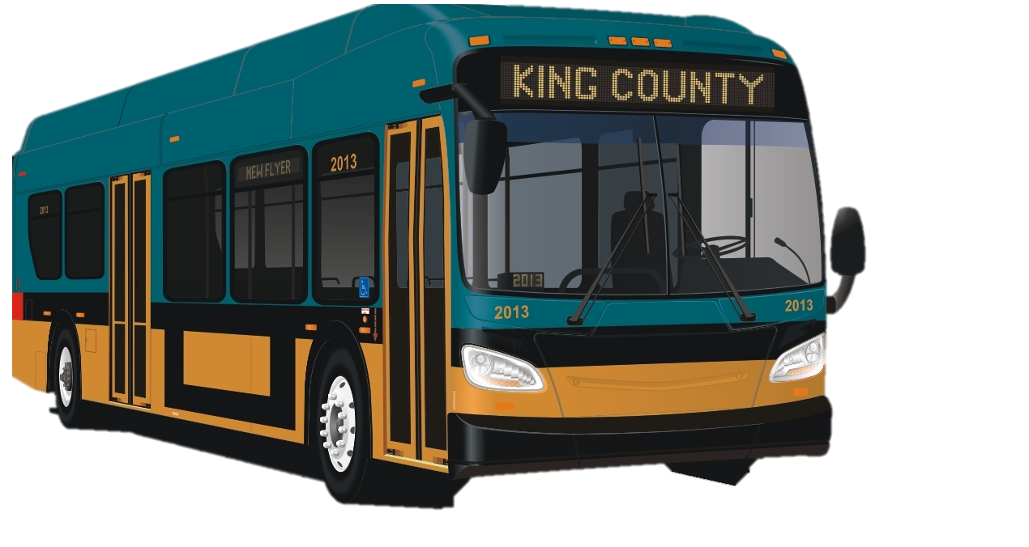
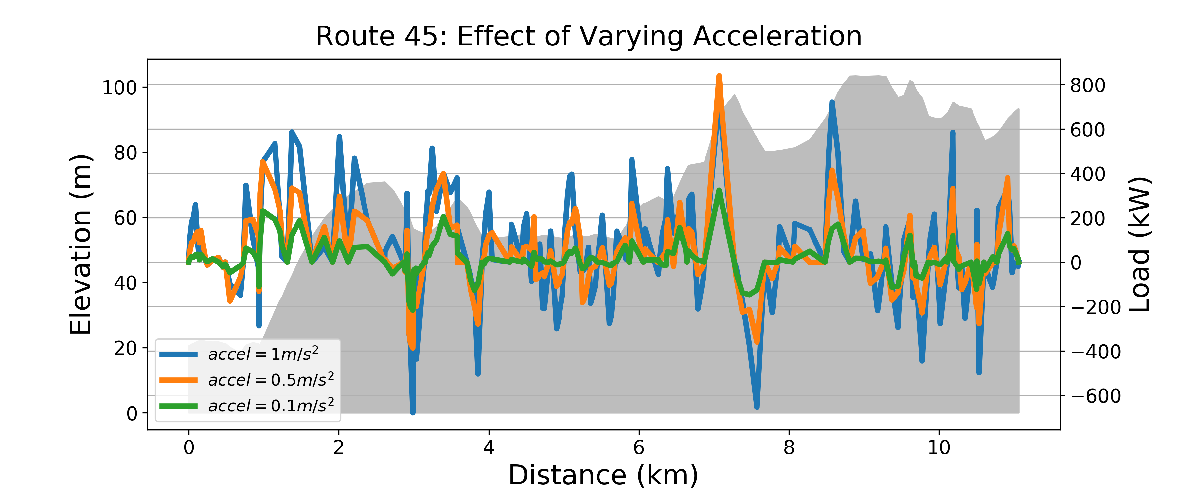
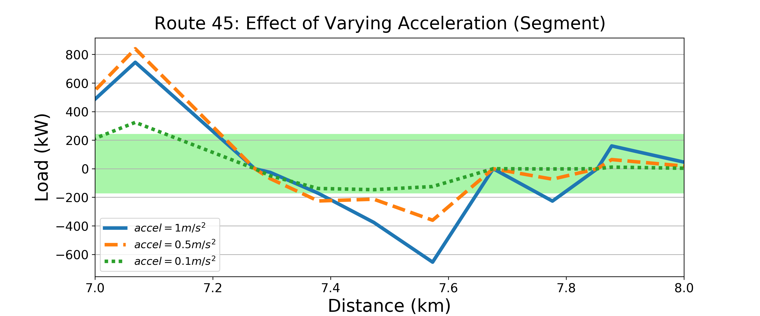

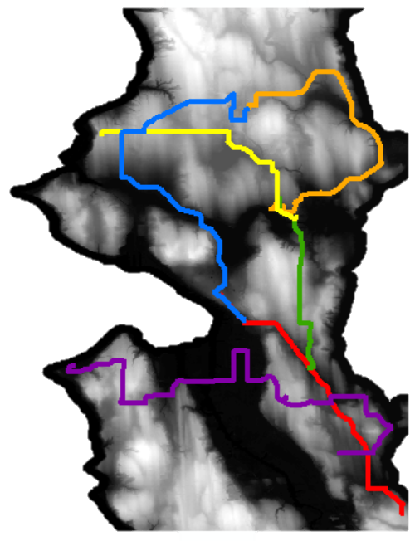
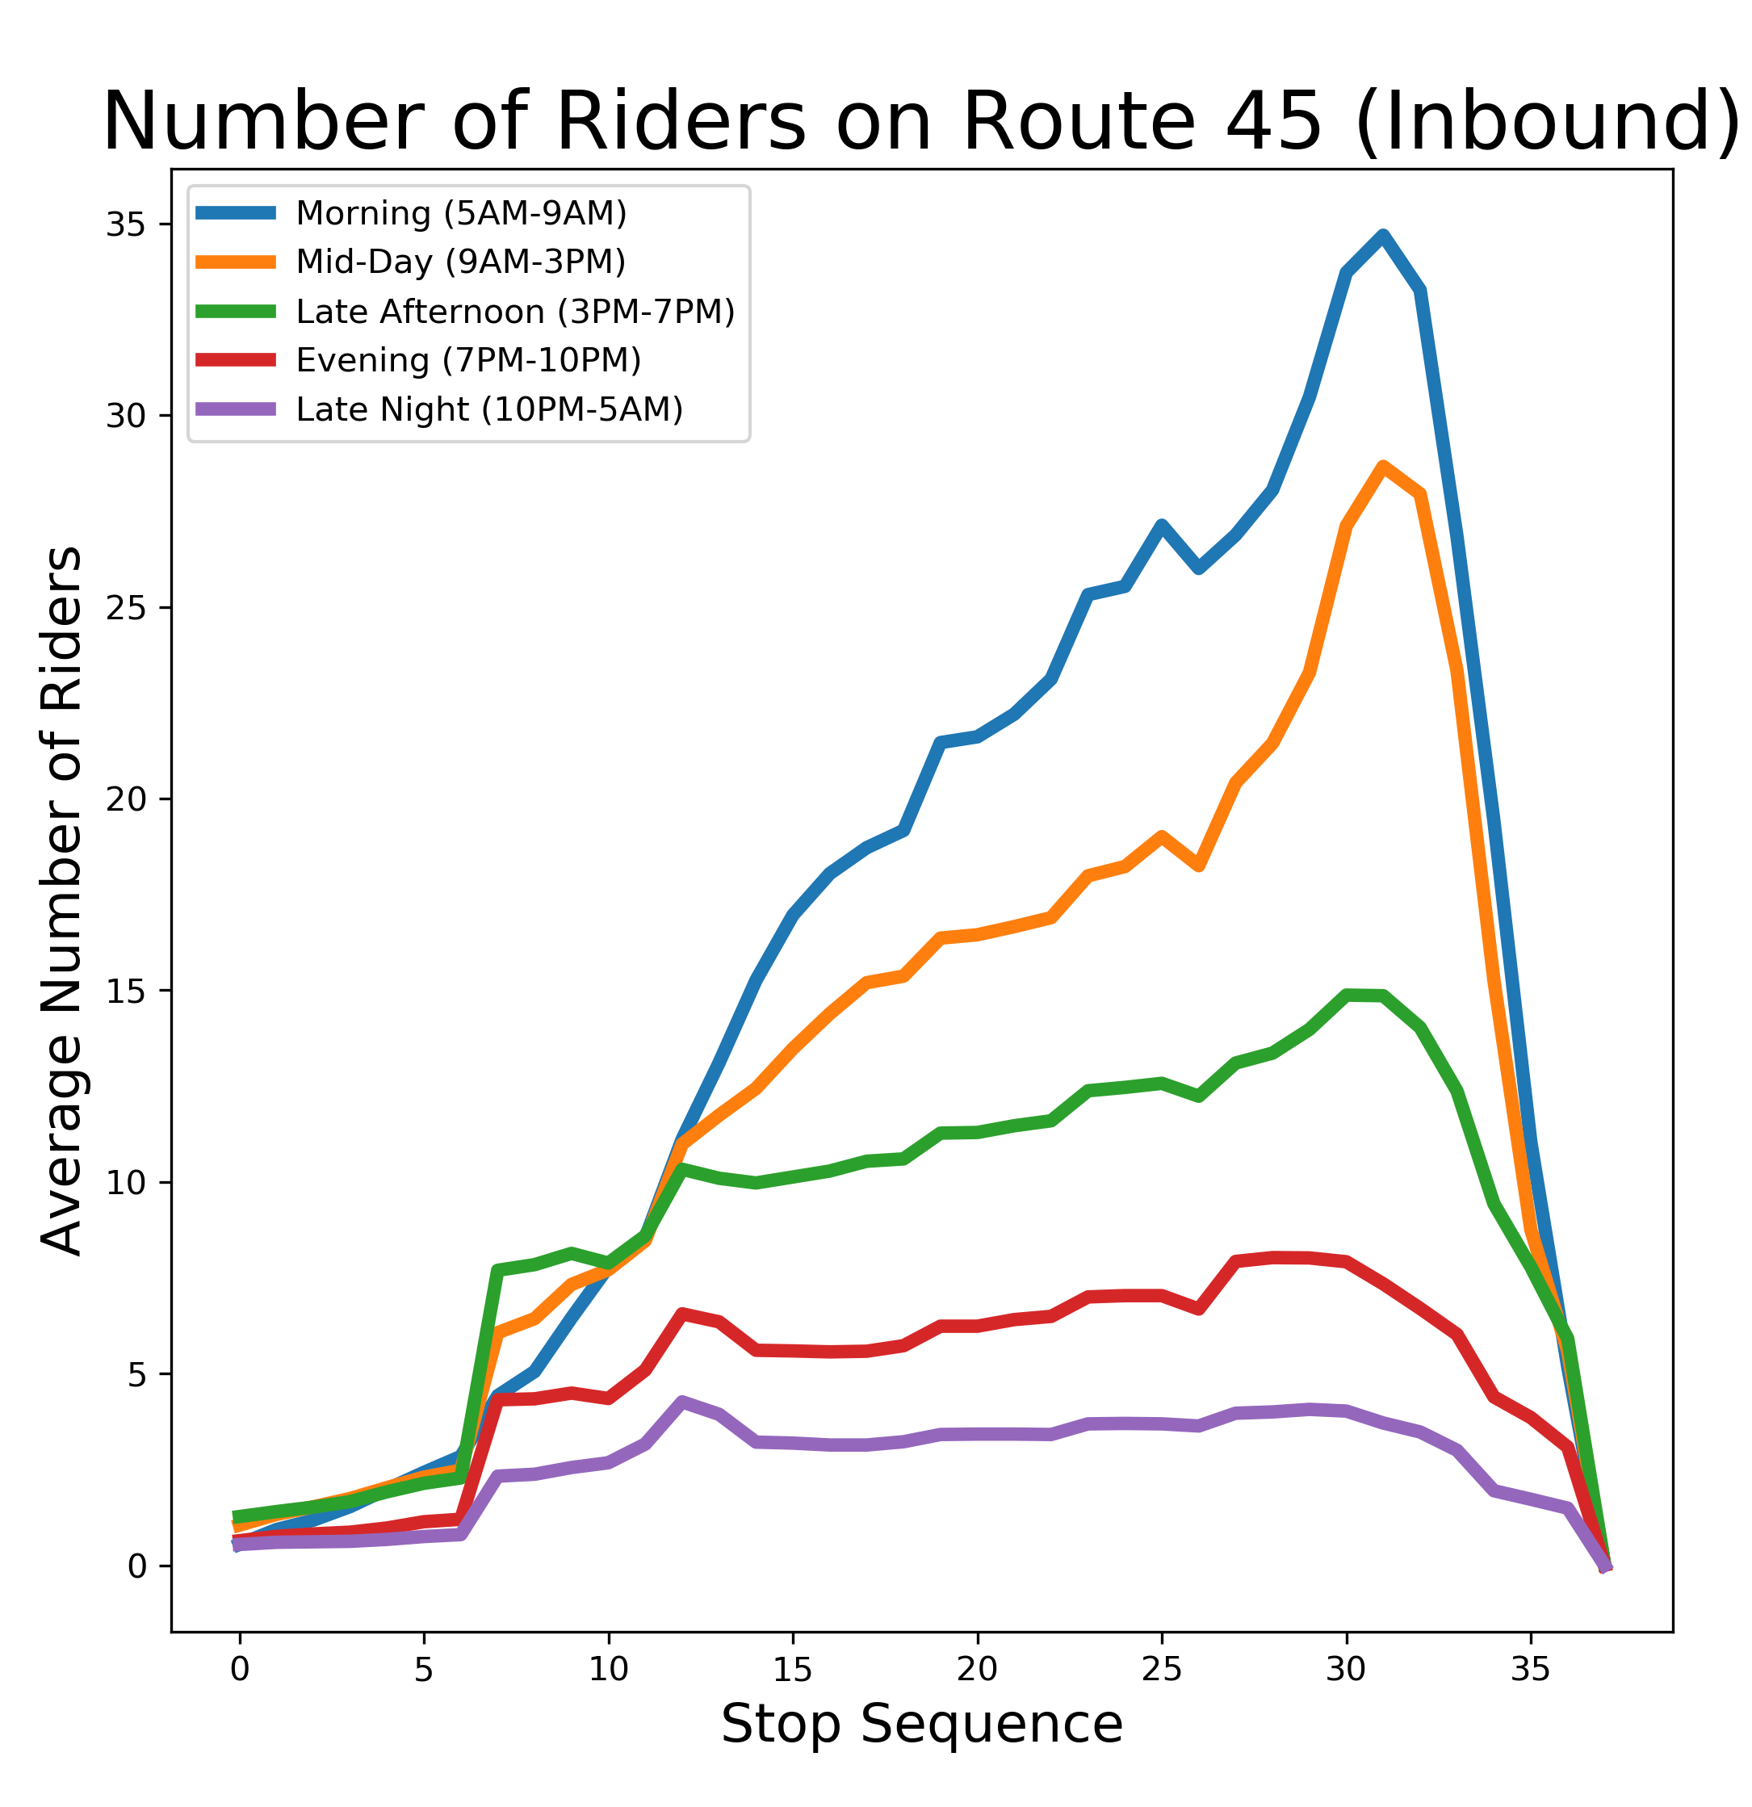
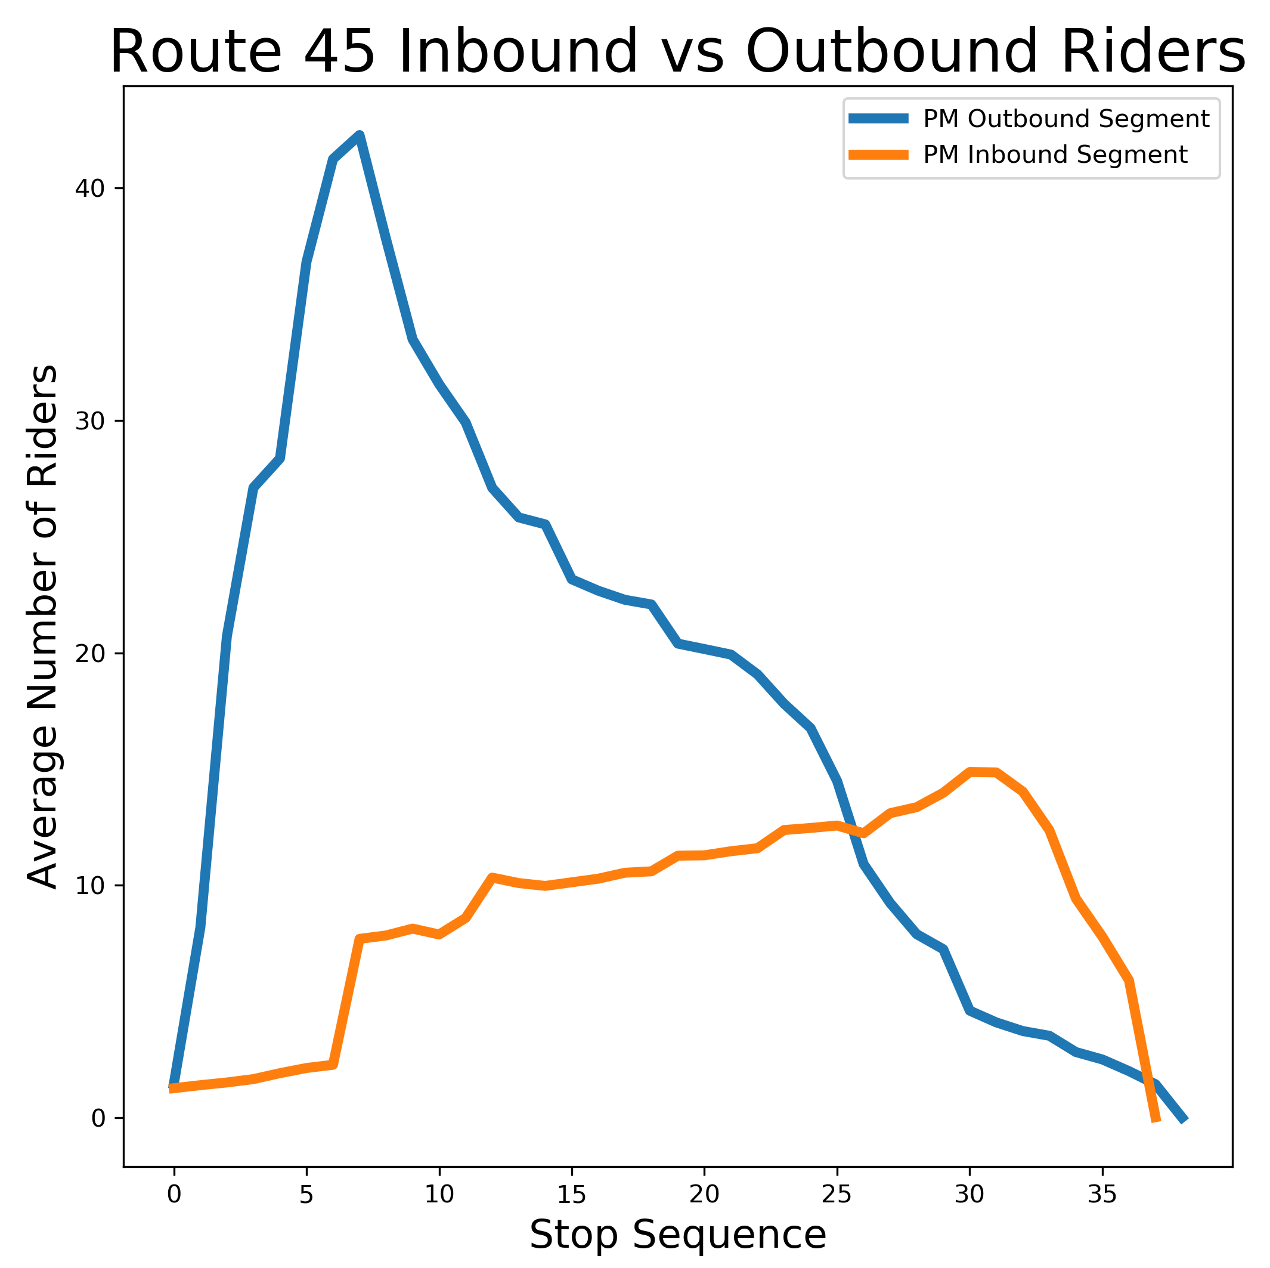

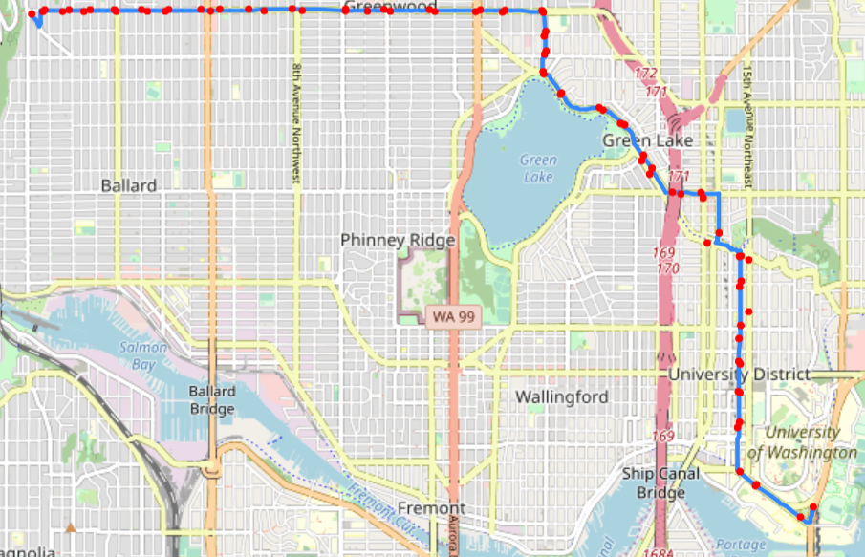
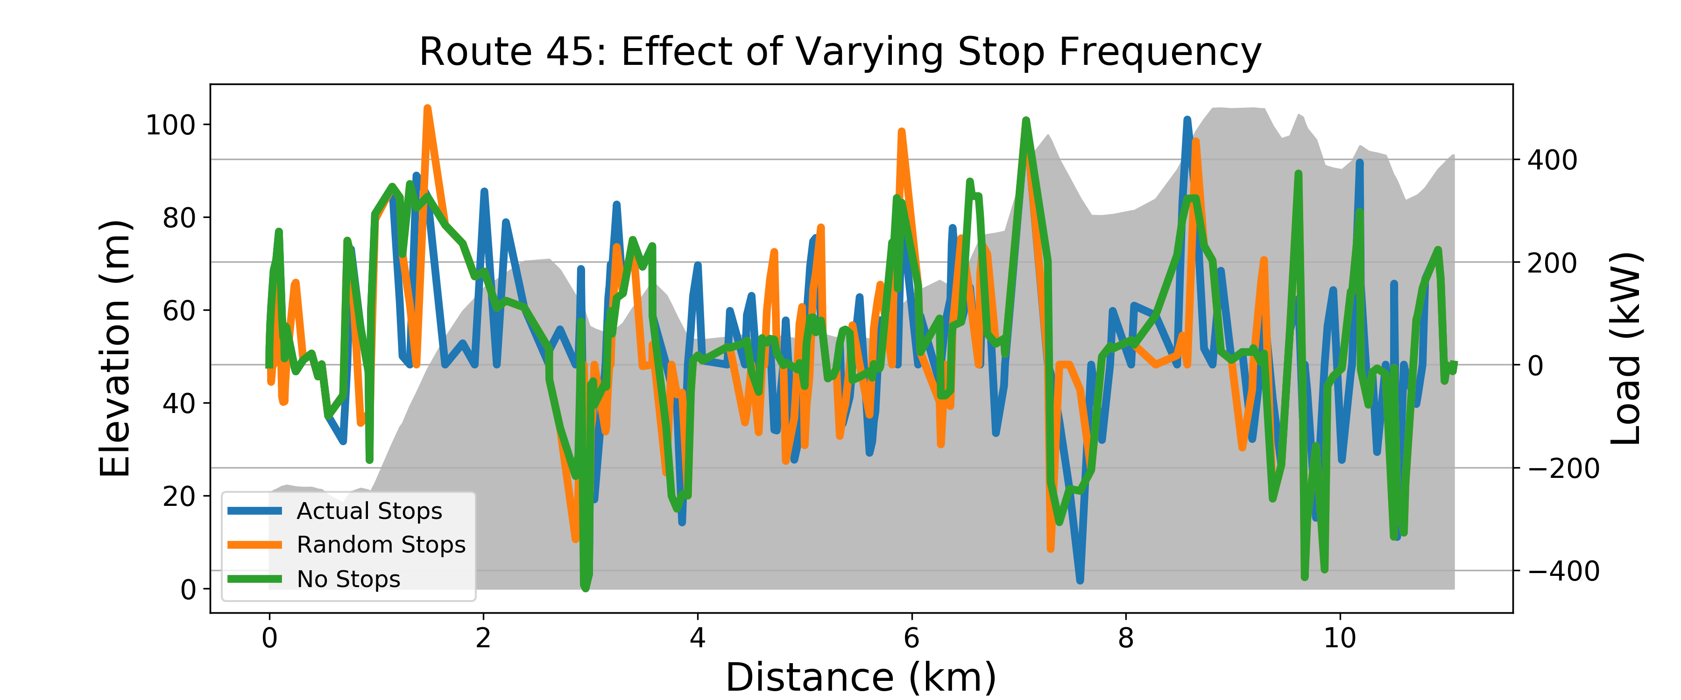
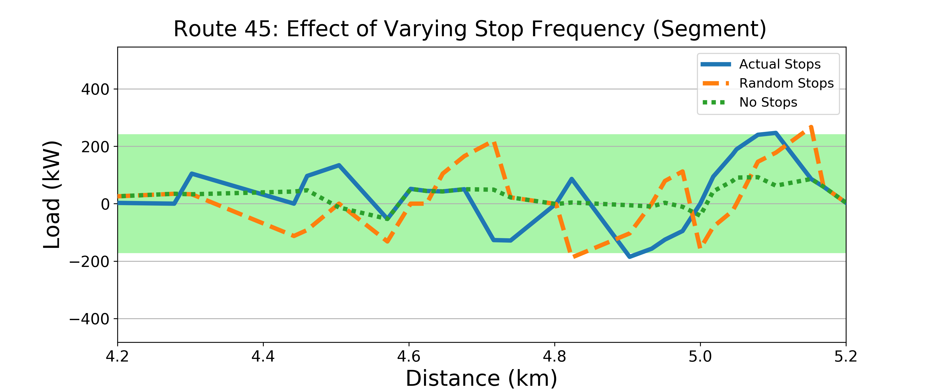
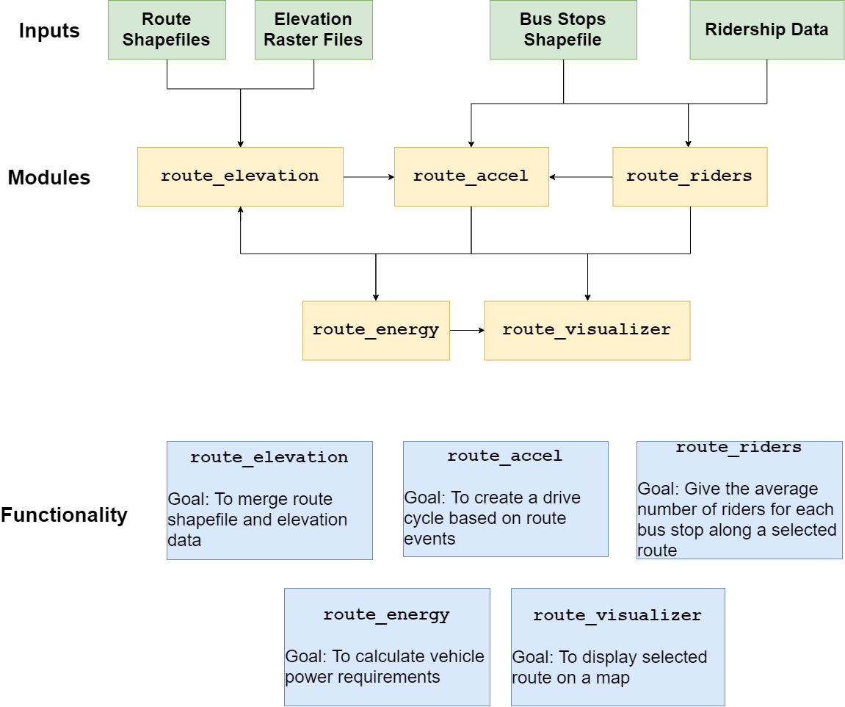
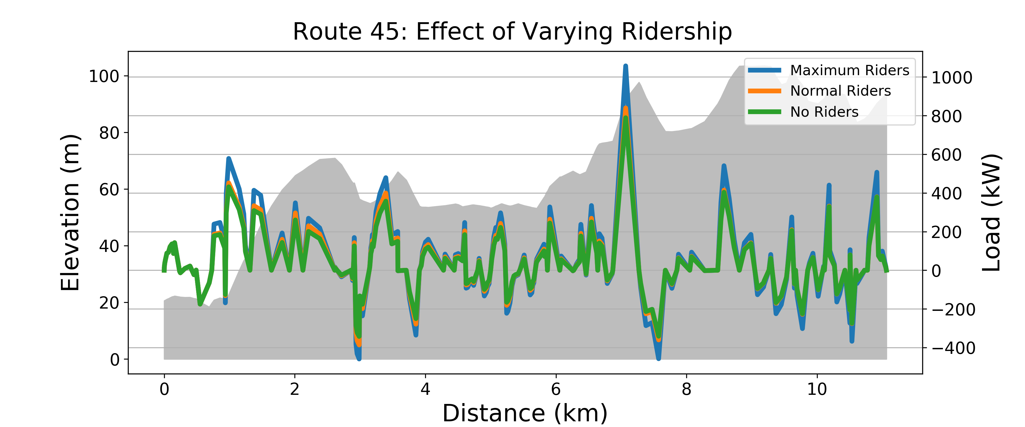
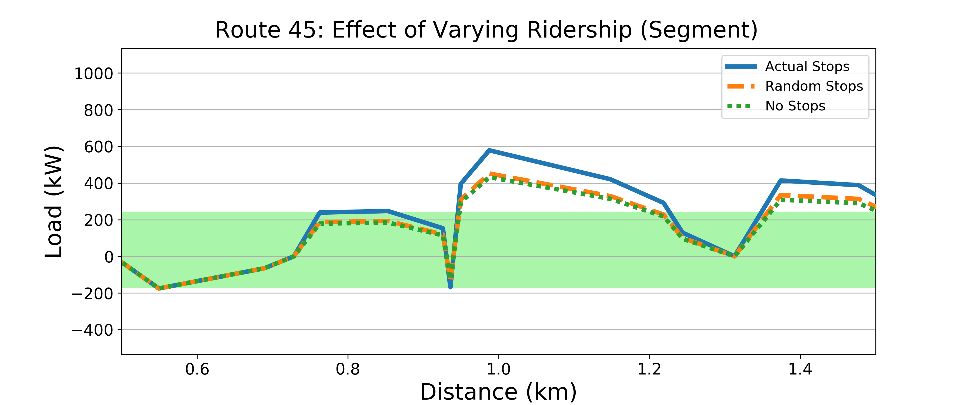
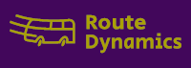
Route_Dynamics: An open-source package for predicting battery load on King County Metro Bus routes
Ryan Carlin, Erica E. Eggleton, Harrison Goldwyn
Purpose
Results
King County Metro is transitioning to a fully electrified fleet, including diesel hybrid-electric, electric trolleys, and battery-electric vehicles.
Metro’s battery maintenance protocol is currently reactive.
The vehicle drive train, drive cycle, and route characteristics are not considered in battery replacement and route planning.
There is an opportunity to lower costs using a predictive maintenance model
Plots on the left show the load profiles for the entire route with the elevation profile as the background. The plots on the right show a 1 km segment of the route. The green shaded area has an upper bound of 240 kW, the limit of the electric motor, and a lower limit of -170 kW, the limit of power the batteries can receive from regenerative braking.
Package Overview
The scenario with a constant acceleration of 1 m/s² is the most energy intensive.
The scenario with no stops was the least energy intensive and the other two were about the same.
The scenario with maximum riders is the most energy intensive.
Base-case parameters: Acceleration = 0.5 m/s², Velocity Limit = 35 mph, Empty bus mass = 19051 kg
Future Work
Add more points (e.g. interpolation) for higher resolution along the route for a smoother elevation profile and load profiles
Combine elevation surface and terrain models to account for bridges and overpasses
Create package module for data cleaning to minimize the need for ArcMap
Create a database that links load profiles to specific routes, bus IDs, and module IDs
References: [1] King County GIS Data Portal. (2017, April), [2] WA Department of Natural Resources, Lidar Portal. (2016)

